Slide 1
Webmaster updates
Sarah Tao and vincent yang

Slide 2
Overview
Why not WordPress?
Changes
Hosting/prices
Long term
Comments/Suggestions

Slide 3
Why not wordpress?
Code
Wordpress
Higher learning curve
Less limiting
Support from different ideas
Higher levels of control – Reduce abstraction layers
MIT License
Security
Easy to use and maintain
25% of the internet
Roles give editing power
Plugins and themes that are often different
No support
Incomplete documentation
MySQL
Bad SEO

Slide 4
Changes
Calendar
SEO

Slide 5
Hosting and prices
GoDaddy
Github pages
Hosting
Google Domains

Slide 6
Github
Source control – see your code at any point in time
Code collaboration – work with multiple people
Open source + licensing
Web hosting – Github Pages

Slide 7
Long term
Users
Blog
Calendar
Store information (ex: Presentations)
Work on site – everybody else can view
Trello
Self-sustainability
Heroku
Wiki
Resources: file archive through user accounts
Why not Drive/Dropbox?
Class reference

Slide 8
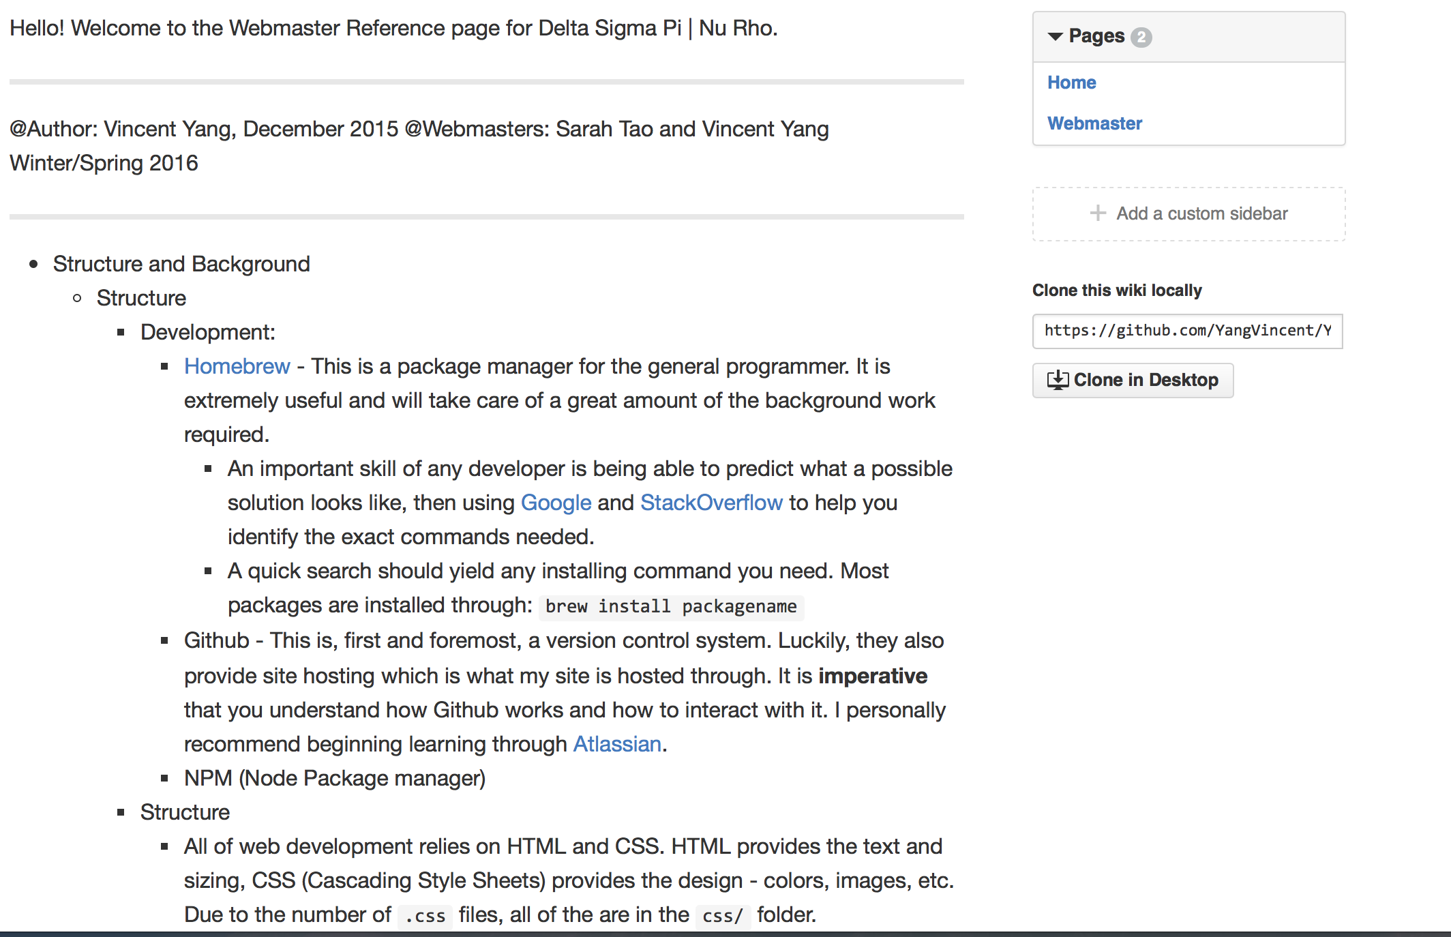
Wiki

Slide 9
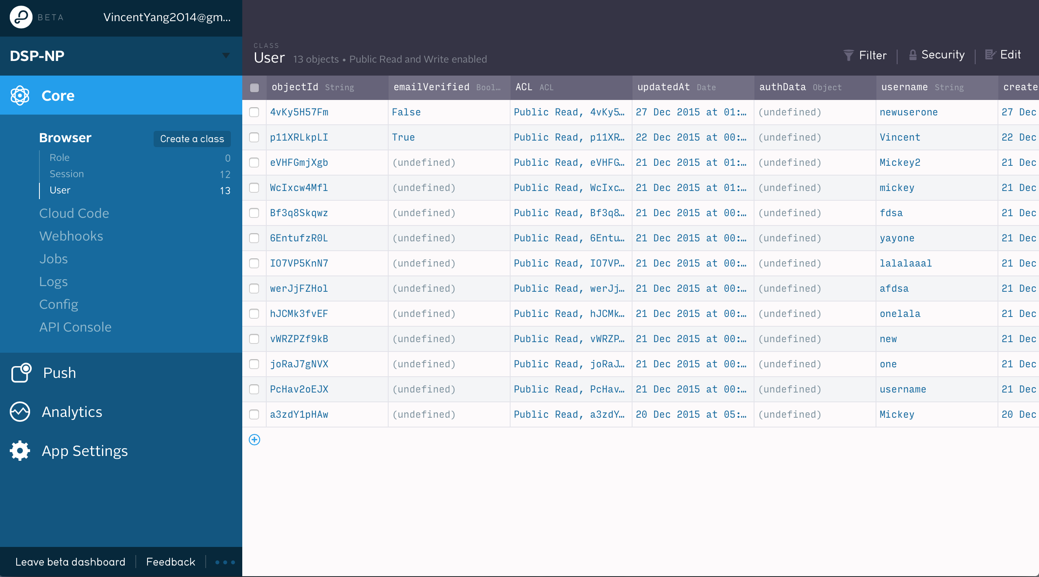

Slide 10
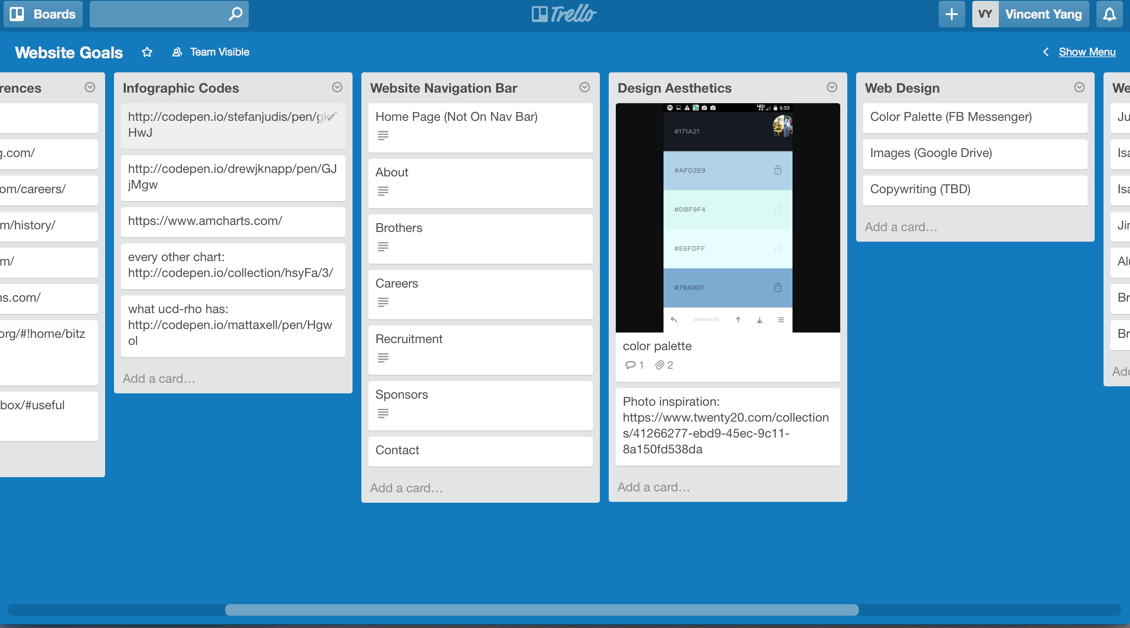

Slide 11
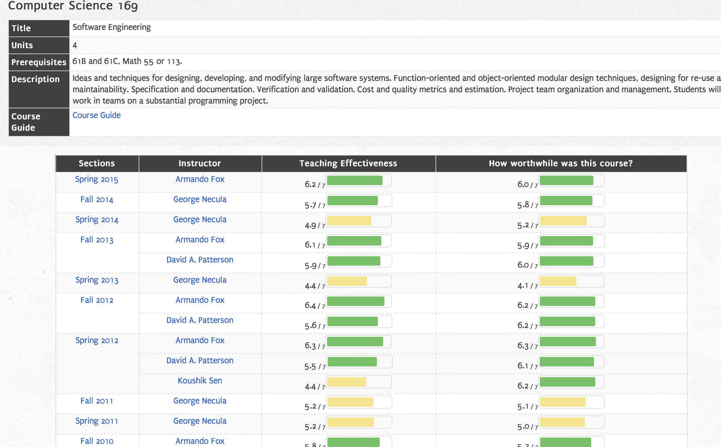

Slide 12
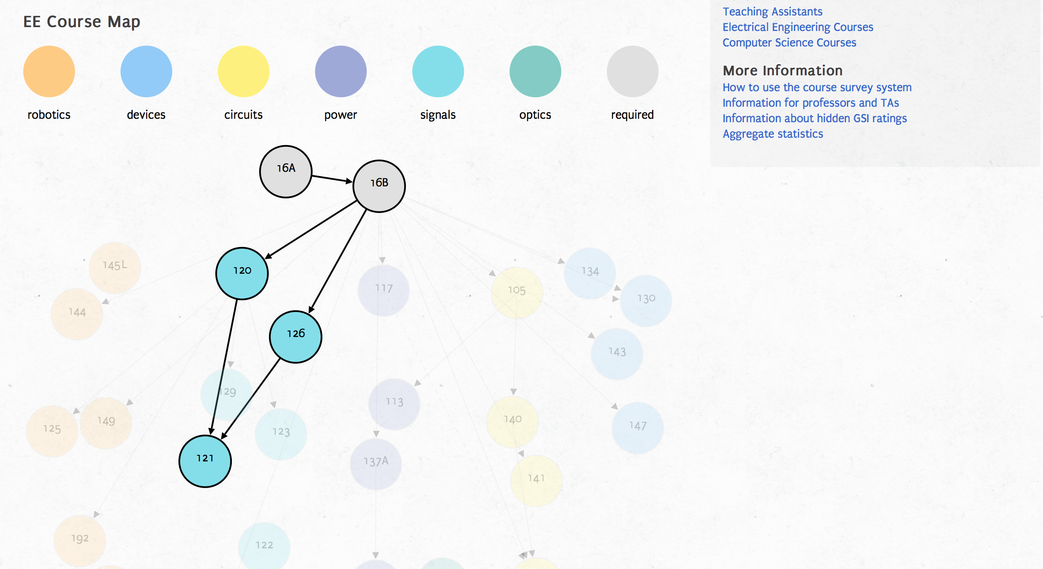
eta theta nu at berkeley

Slide 13
Questions?
Comments and/or suggestions to np.webmasters@gmail.com

